Slide 1

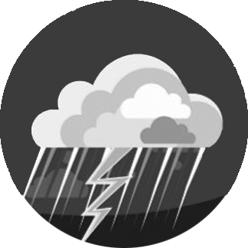

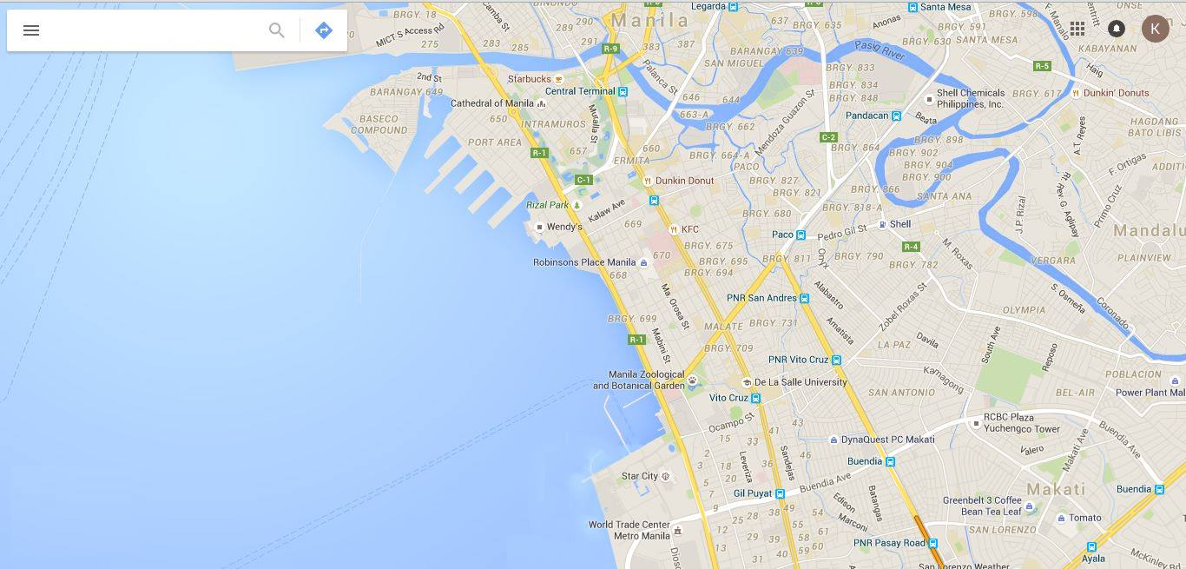


Aegis
Infographics
Contact Numbers
Login

Slide 2

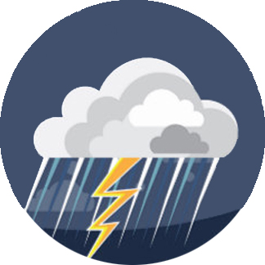
Aegis
Infographics
Contact Numbers
Login

Slide 3

Aegis
Infographics
Contact Numbers
Login

Slide 4
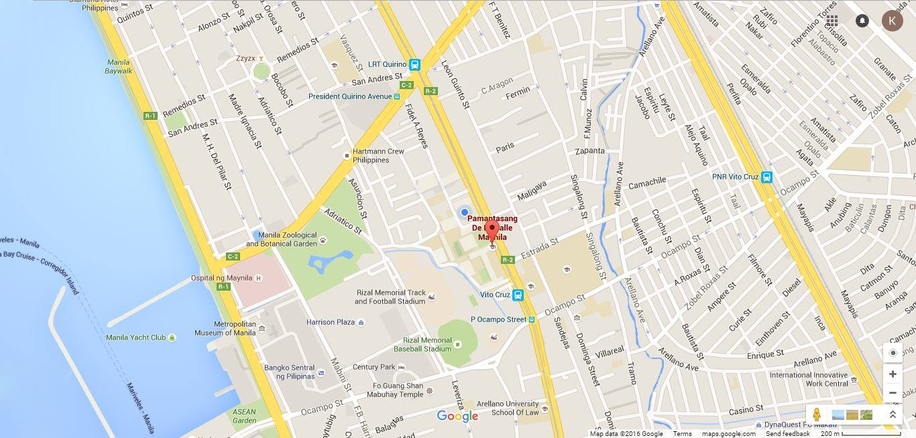

Aegis
Infographics
Contact Numbers
Login

Slide 5

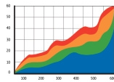
Aegis
Infographics
Contact Numbers
Login
Analytics
Flood History:
Risk Score:
Your area has a
69%
of getting flooded

Slide 6
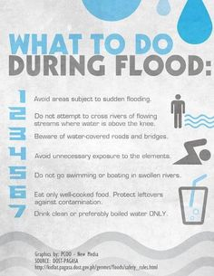
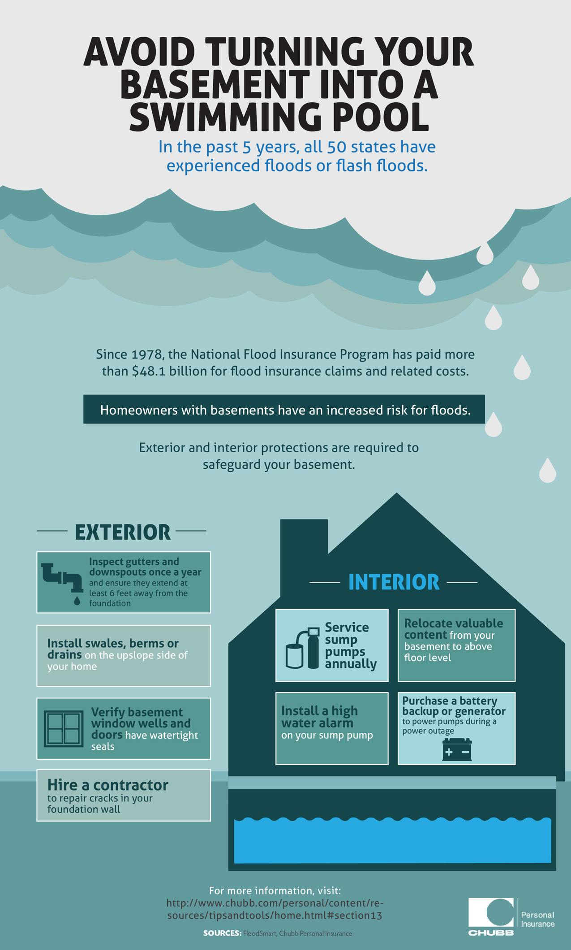
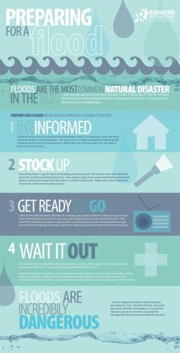
Aegis
Infographics
Contact Numbers
Login
of getting flooded

Slide 7

Aegis
Infographics
Contact Numbers
Login
Login
Username
Password
Create an account
Login

Slide 8
Aegis
Infographics
Contact Numbers
Login
Sign Up
Username
Password
Create an account
Sign Up

Slide 9





Aegis
Infographics
Contact Numbers
Login
NDRRMC
NDRRMC
NDRRMC
For damage assessment and consolidated reports on government action
For damage assessment and consolidated reports on government action
For damage assessment and consolidated reports on government action
Hotlines:
(02) 911-1406
(02) 912-2665
(02) 912-5668
(02) 911-5061 to 64
Hotlines:
(02) 911-1406
(02) 912-2665
(02) 912-5668
(02) 911-5061 to 64
Hotlines:
(02) 911-1406
(02) 912-2665
(02) 912-5668
(02) 911-5061 to 64
Social Media:
Social Media:
Social Media:

Slide 10
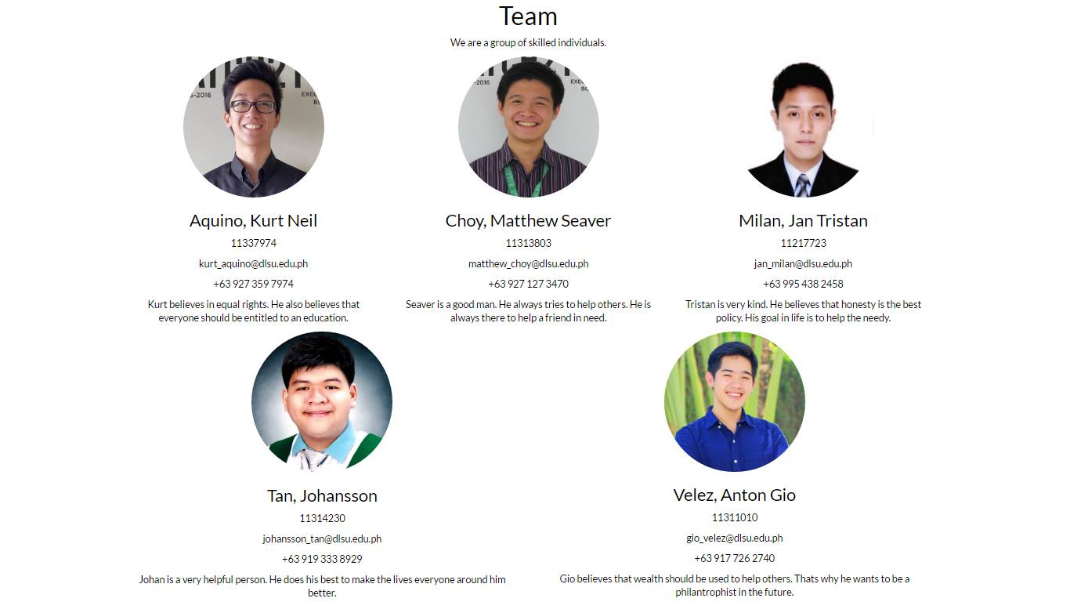
Aegis
Infographics
Contact Numbers
Login

Slide 11
Aegis
Infographics
Contact Numbers
Gary
Contacts
Groups
Help
Settings
Logout

Slide 12
Aegis
Infographics
Contact Numbers
Gary
Contacts
My Groups
Groups
Help
Settings
Logout

